Slide 1
Advanced Front-End Programming (CPAN 144)
Week 1
Lecturer: Harshdeep Singh
Winter 2023

Slide 2
Agenda
What is a Web Application?
Web API
What is a web service?
Full Stack Development Technologies
MEAN & MERN Stack
Reviewing a few JavaScript libraries

Slide 3
What is the focus of this course?
In this course, you will learn to create more functional front ends that work with a web service (back end servers).
Throughout the course, you will learn foundational concepts, skills, and technologies that will enable you to create high-quality intermediate- and advanced-level web applications in the future. These foundations will include:
More JavaScript
Front end tools
REACT(what we’re all here for!)

Slide 4
Some questions we’ll be answering today
What is a web application?
What is a Web API?
What is a Web Service?
What is full stack development?

Slide 5
Web Application
A functional application that solves a problem
Google is a web app(helps you search for stuff on internet)
ChatGPT is a web app(helps you generate text based on a given prompt)
Web applications are a type of client/server application.
In a client/server application, a user at a client computer accesses an application at a server computer. For a web application, the client and server computers are connected via the Internet or an intranet

Slide 6
Web API
APIs are smaller bits of your web application(usually on the server) that help you achieve a simpler task(such as login, registration, searching or updating stuff)
Web APIs are like web addresses (end points) which are built to do some task when someone requests them

Slide 7
Sample API
jsonplaceholder
jsonplaceholder service which shares sample data through API for developers in the following JSON formats
You can search for users, posts, photos
https://jsonplaceholder.typicode.com/posts
https://jsonplaceholder.typicode.com/photos
https://jsonplaceholder.typicode.com/users

Slide 8
What is Web Service?
It is an API that lives on a server.
Its purpose is to perform a particular task for your web application(such as examples we covered in the previous slide)
The API usually takes in and gives out data(request and response) in a particular format(XML, JSON, etc)
Web service is the one which your apps (web as well as mobile) as well as other apps (if you provide access) can use.
Facebook's 'Like' button in any website or you can provide 'Login' functionality through Facebook that is because Facebook has exposed this functionality as a web service

Slide 9
Full stack Development
Full Stack developers can easily switch between front-end and back-end development roles based on project requirements

Slide 10
What is full stack JavaScript development?
A full stack JavaScript developer is an engineer that can develop both the frontend and the backend applications using JavaScript technologies.

Slide 11
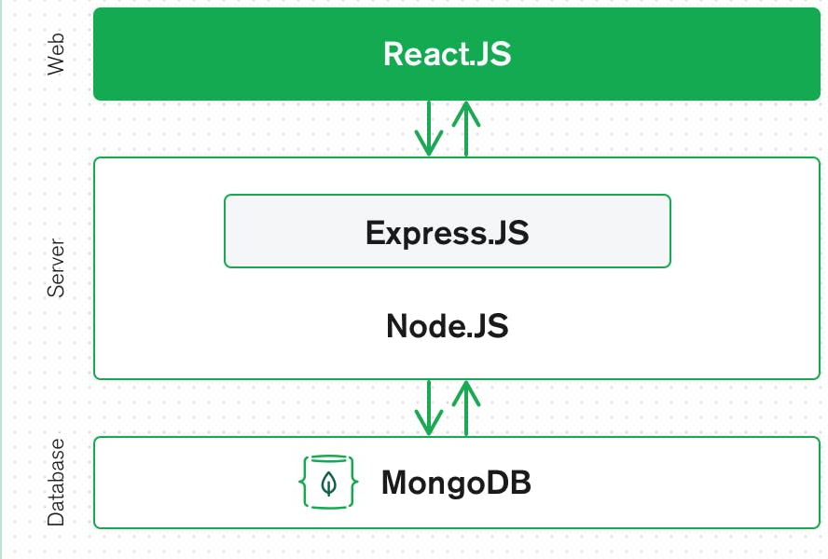
MERN Stack Development

Slide 12
Front end Frameworks
Front-end web development is the process of transforming the data to a graphical interface, through the usage of CSS, HTML, and JavaScript so that the users can observe and network with that data.
The primary uses of front end frameworks are that they create interactive tools and develop responsive websites.
Famous front end frameworks: React, Angular, Vue

Slide 13
Moment.js
Moment.js is one of the practical Javascript libraries that help developer in processing Date, Time values and display them in proper format in UI
Let’s have some practice with this library: https://momentjs.com/guides/

Slide 14
Activity 1
Create an html document.
Add Moment.js library to the document.
Display the current date in the format of the YYYY MM DD
Show it to the instructor! (0.5% Mark)

Slide 15
Lodash.js
Lodash is a popular javascript based library which provides 200+ functions to facilitate web development.
It provides helper functions like map, filter, invoke as well as function binding, javascript templating, deep equality checks, creating indexes and so on.
Let’s have some practice with this library:
https://lodash.com/

Slide 16
Activity 2
Create an html document.
Add Lodash.js library to the document.
Create an array with at least 3 members.
Use lodash to display the first member of the array in an alert dialog.
Show it to the instructor! (0.5% Mark)

Slide 17
Lab 1
Navigate to Course Content -> Assessments -> Labs -> Lab 1 and download the instruction for lab 1.
Once you fulfill all the requirements of the lab ZIP all your source files and submit them into Course Content -> Assessments -> Labs -> Lab 1
Pay attention to the due date defined on the blackboard submission box for this activity.

